Slide 1



sean@tinywave.co.kr
스마트 센서 및 데이터 기반
스마트제조/예측정비/산업안전을 위한
온라인 서비스 플랫폼 솔루션
Notes:
안녕하세요 타이니웨이브 이순기 입니다.
타이니웨이브는 스마트 센서 및 데이터 기반 스마트 제조/예측정비/산업안전을 위한 온라인 서비스 플랫폼 솔루션을 개발 공급하는 회사입니다.

Slide 2



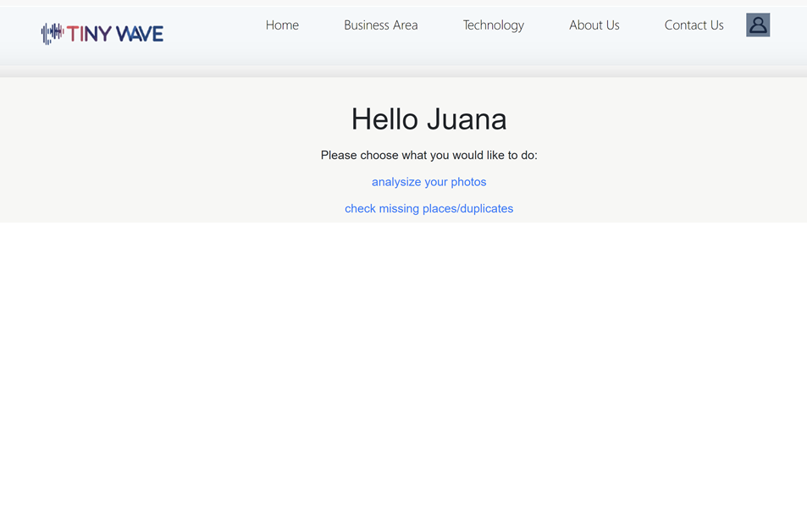
TINYWAVE Demo Page

Slide 3

진동 기반 발전 및 센서 시스템 개발
TINYWAVE Demo Page
1. Drawing and Product Inspection Solution
2. Computer Vision Based Inspection Solution
3. Smart Sensor Monitoring Dashboard
4. Predictive Maintenance Dashboard
저비용으로 작업자의 안전확보 및 설비의 최적 유지보수 가능

Slide 4

1. Drawing and Product Inspection Solution

Slide 5
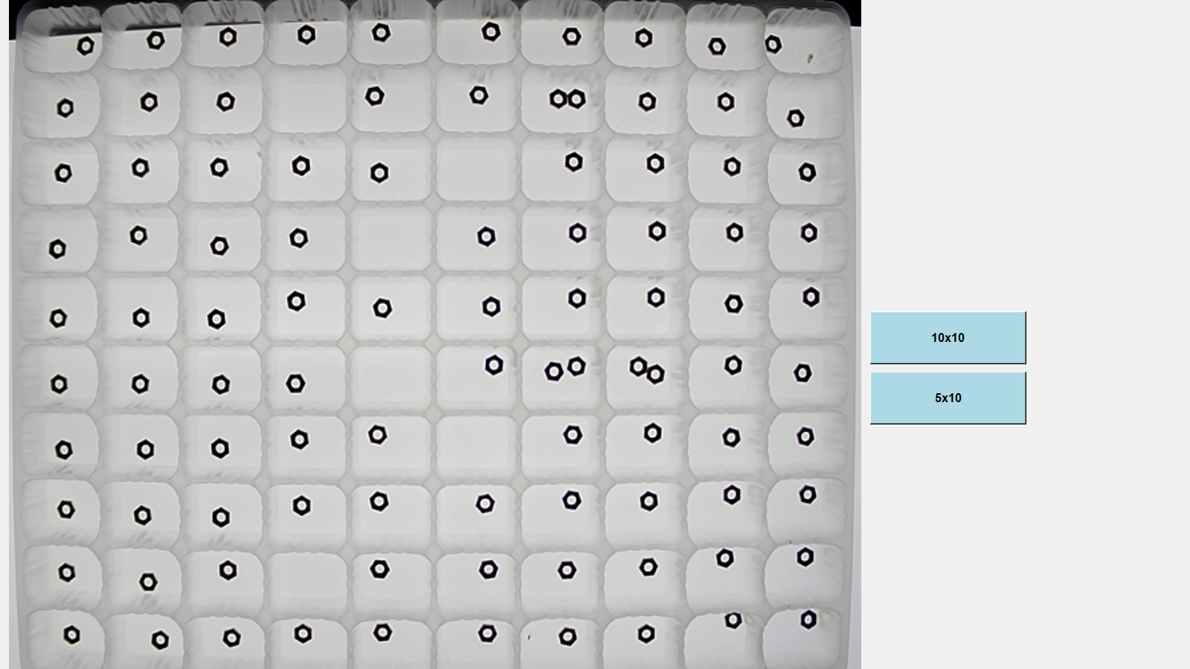
2. Computer Vision based Inspection Solution
Real Time Image
Two types of Tray

Slide 6
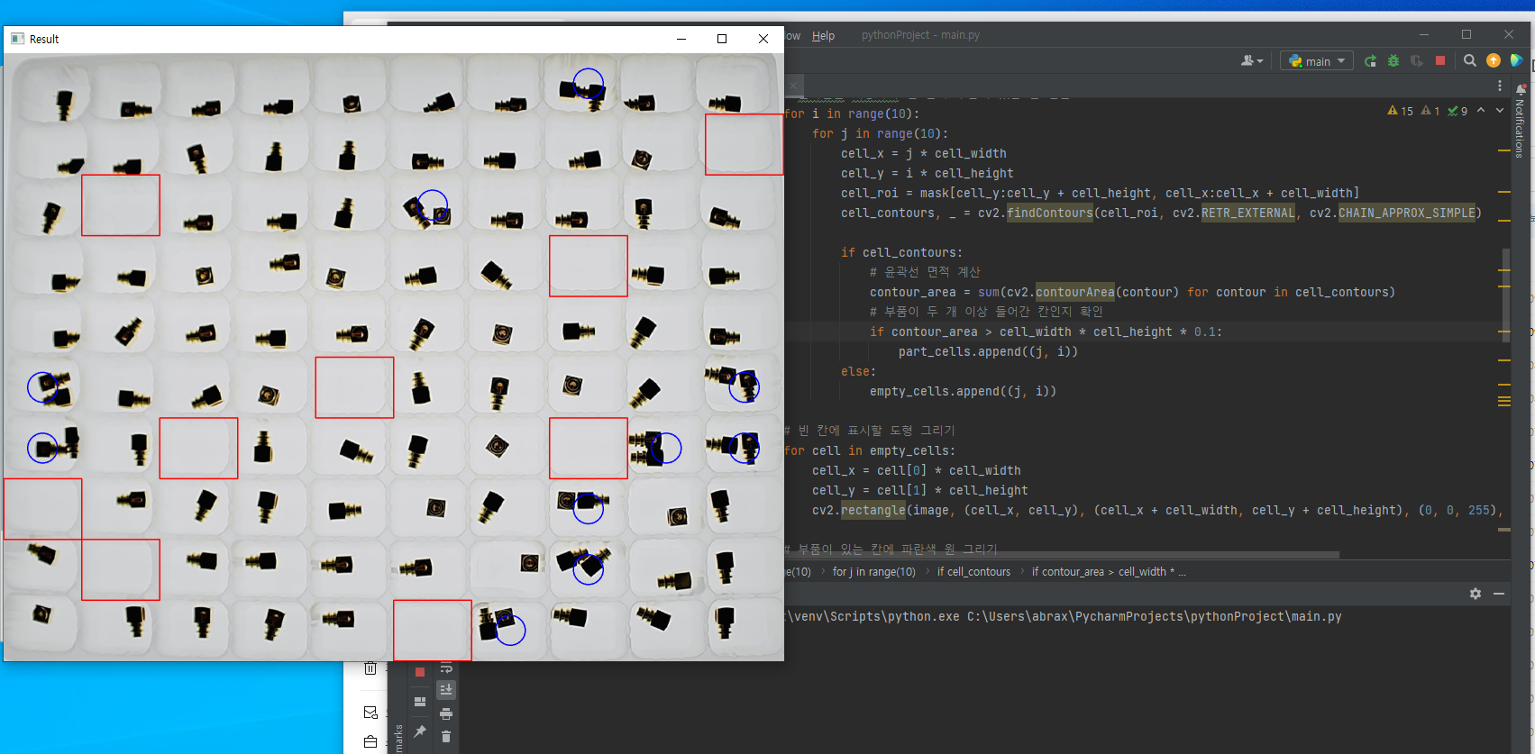
2 Computer Vision based Inspection Solution

Slide 7
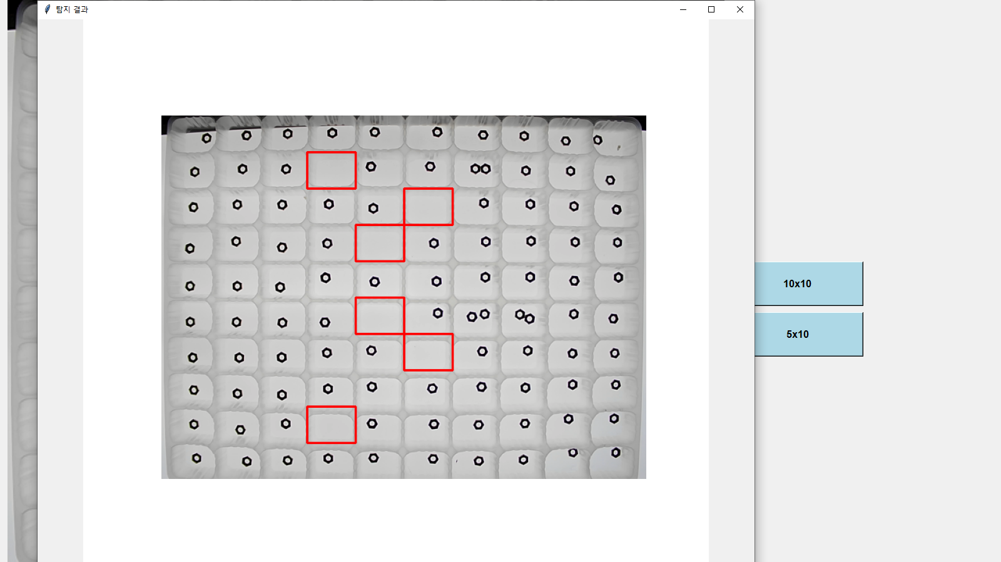
2 Computer Vision based Inspection Solution
Result of inspection
Empty : Red Rect
More than 2 : Blue Circle

Slide 8
3. Smart Sensor Monitoring Dashboard
Temperature
Humidity
Vibration
Current
Radar
LiDAR
Camera Vision

Slide 9

4. Predictive Maintenance Dashboard

Slide 10
4. Predictive Maintenance Dashboard
'machine failure' label indicates if at least one of the following failure types is true, the process fails and the label is set to 1.
tool wear failure (TWF): The tool will be replaced of fail at a randomly selected tool wear time between 200 â€“ 240 mins (120 times in our dataset).
heat dissipation failure (HDF): HDF occurs if the difference between air- and process temperature is below 8.6 K and the rotational speed is below 1380 rpm. This is the case for 115 data points.
power failure (PWF): The product of torque and rotational speed (in rad/s) equals the power required for the process. If this power is below 3500 W or above 9000 W, the process fails, which is the case 95 times in our dataset.
overstrain failure (OSF): Similar to overworked/burnout. If the product of tool wear and torque exceeds 11,000 minNm for the L product variant (12,000 M, 13,000 H), the process fails due to overstrain. This is true for 98 datapoints.
random failures (RNF): Each process has a chance of 0.1 % to fail regardless of its process parameters. This is the case for only 5 datapoints, less than could be expected for 10,000 datapoints in our dataset.
More details at: https://docs.google.com/document/d/14AciCS7MqgjmdySjZuWAOr0xG-LVImvLftsJp5hqGgg/edit?usp=sharing

